Slide 1
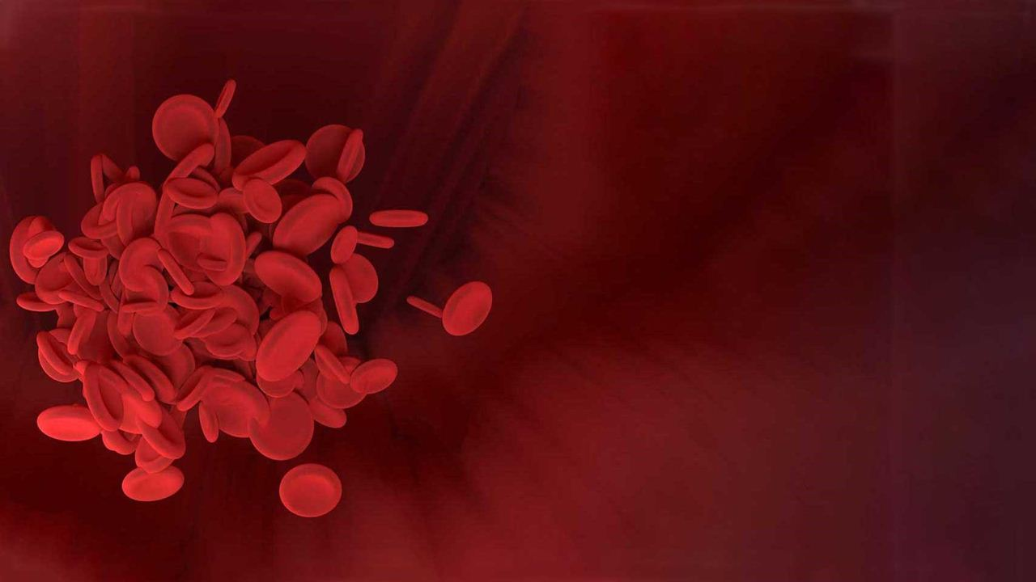
Data visualization & Predictive Analysis of Cardiovascular Disease
CIS 8695: Final Presentation
Abha Sharma, Ifeoluwa Kayode, Sindhuja Reddy, Avinesh Agrawal

Slide 2
Background
This dataset contains records of patient data concerning 12 features:
Age, Gender, Height, Weight, Systolic Blood Pressure, Diastolic Blood Pressure, Cholesterol, Glucose, Smoking, Alcohol Intake, Physical Activity, and the Presence or Absence of Cardiovascular Disease.
Dataset values were collected at the moment of medical examination.
Target class “cardio:”
1 = presence of Cardiovascular Disease
0 = absence of Cardiovascular Disease
70,000 rows of cardio dataset
Link to Kaggle Dataset: https://www.kaggle.com/code/sulianova/eda-cardiovascular-data/notebook
Link to Collab File: https://colab.research.google.com/drive/1PBmy2mUm8_uS7ikWZhNY8tqKMM7PcaXE#scrollTo=GiXyDbCED2kM

Slide 3
Objective
To uncover insights concerning factors that make an individual more likely to acquire cardiovascular disease by use of patient examination results.

Slide 4
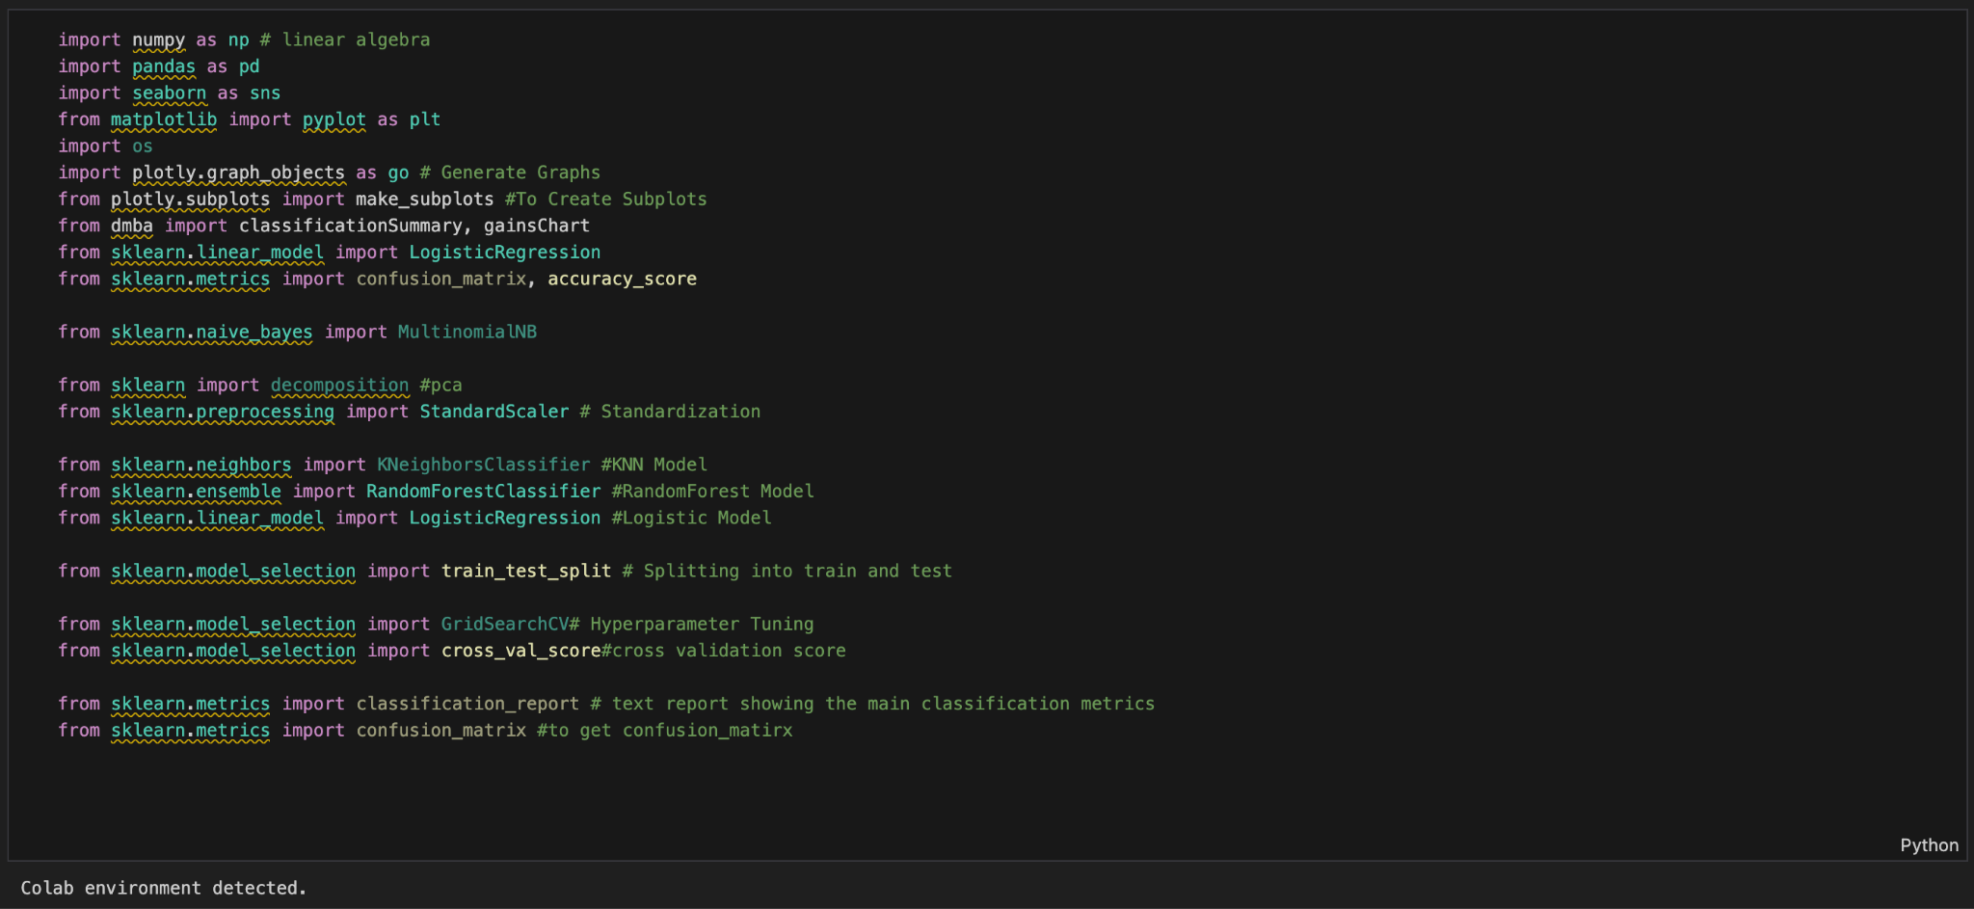
Applicable Libraries + Packages

Slide 5
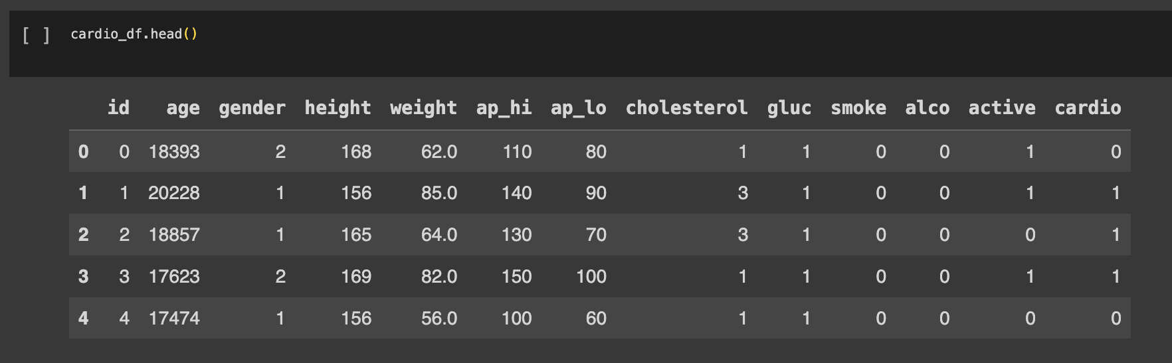
Data Preview

Slide 6
Data Cleaning Process
Handling missing values (no null values present)
Remove duplicate values (no duplicates present)
Removing outliers

Slide 7
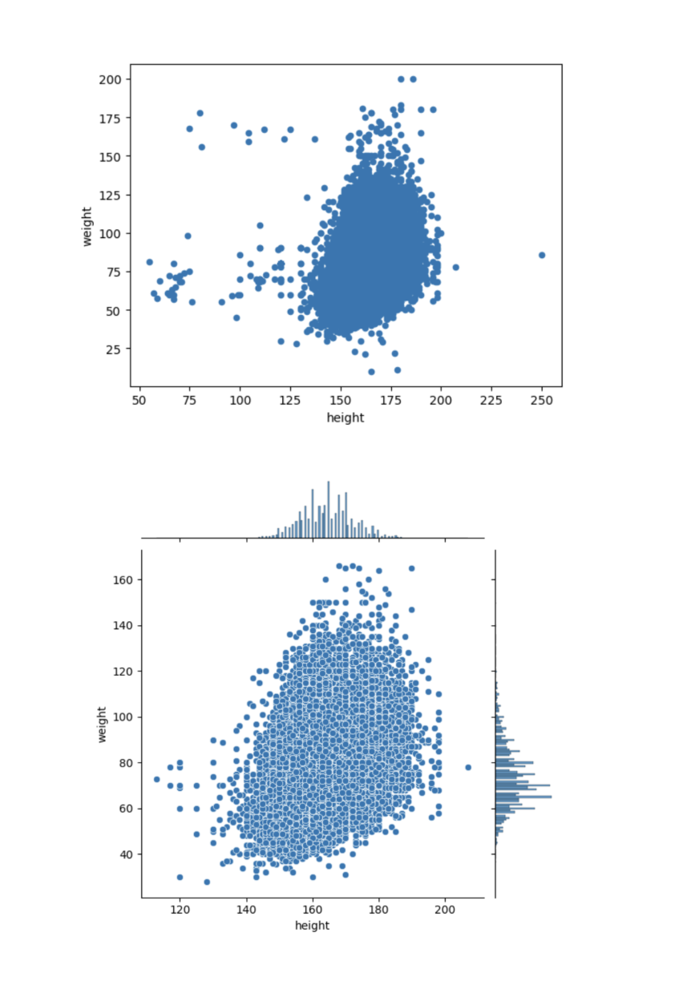
Data cleaning
Scatterplot of Height and Weight with Outliers
Scatterplot of Height and Weight without Outliers

Slide 8
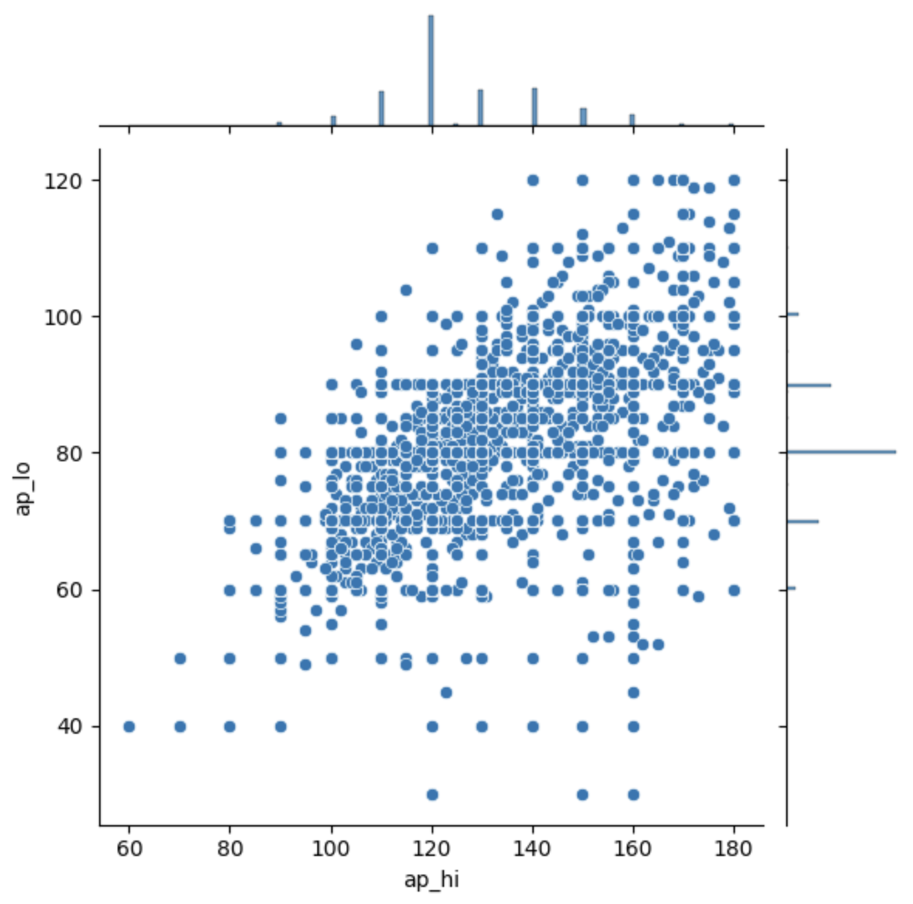
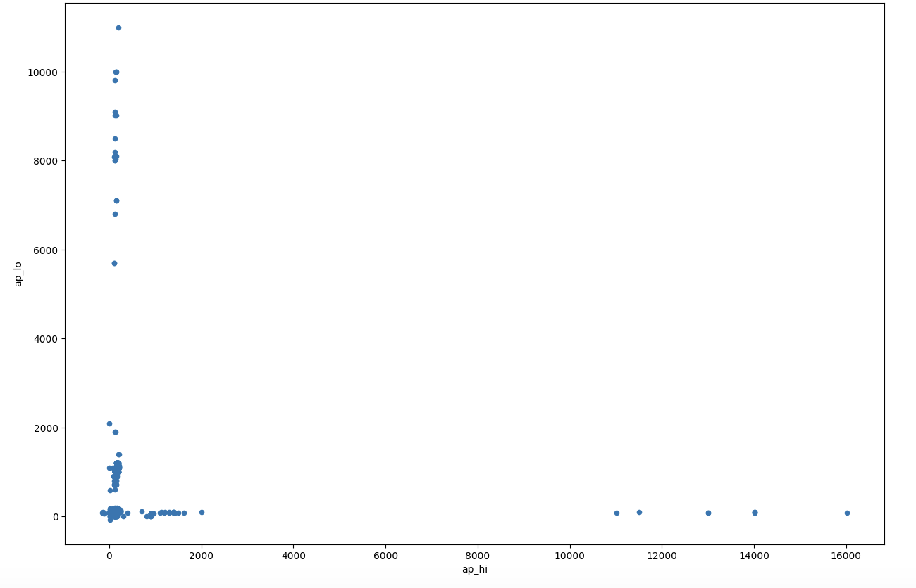
Outliers present among ap_hi (Systolic Blood Pressure)
& ap_lo (Diastolic Blood Pressure)
ap_hi (Systolic Blood Pressure) & ap_lo (Diastolic Blood Pressure) without outliers

Slide 9
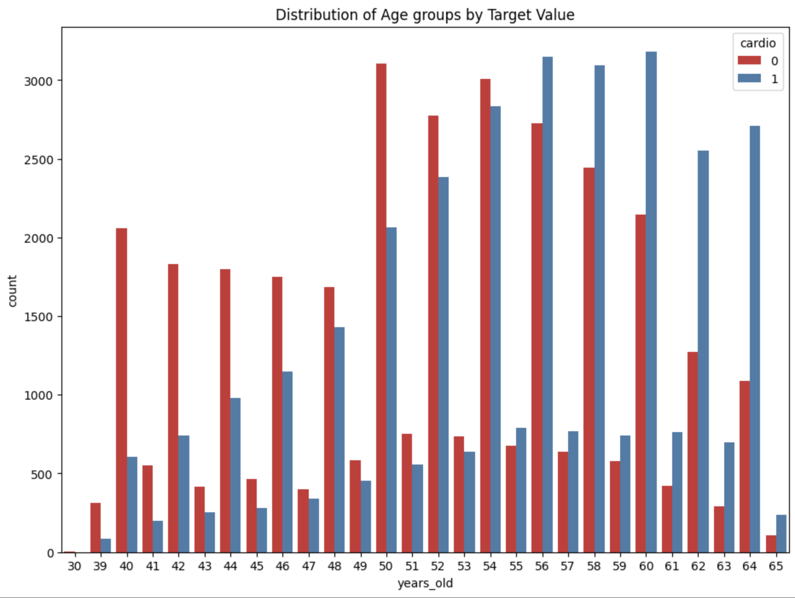
Data Visualization
Higher age groups have a greater likelihood of having cardiovascular disease (CVD).

Slide 10
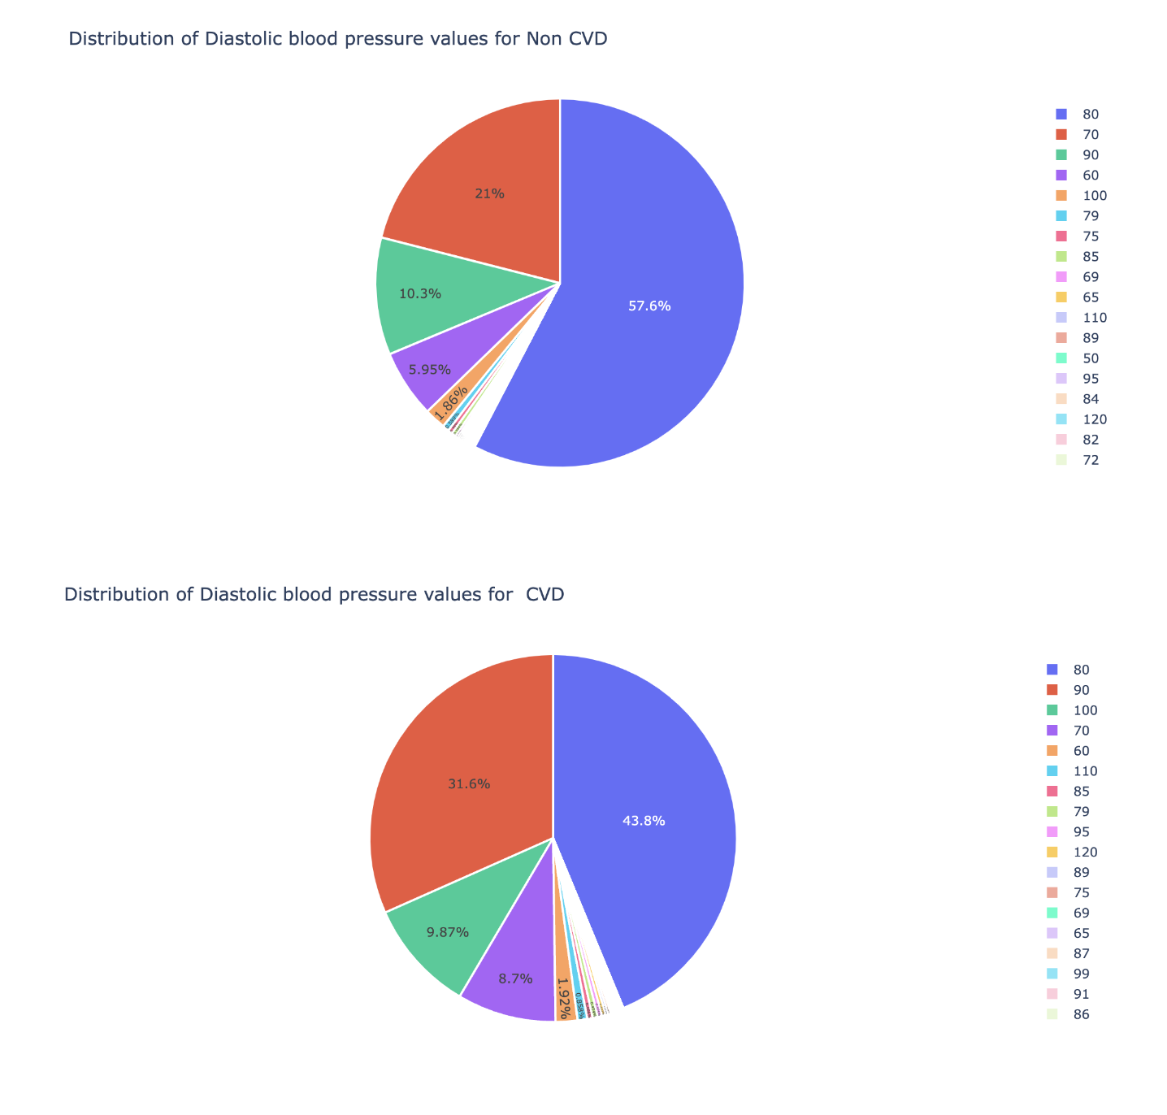
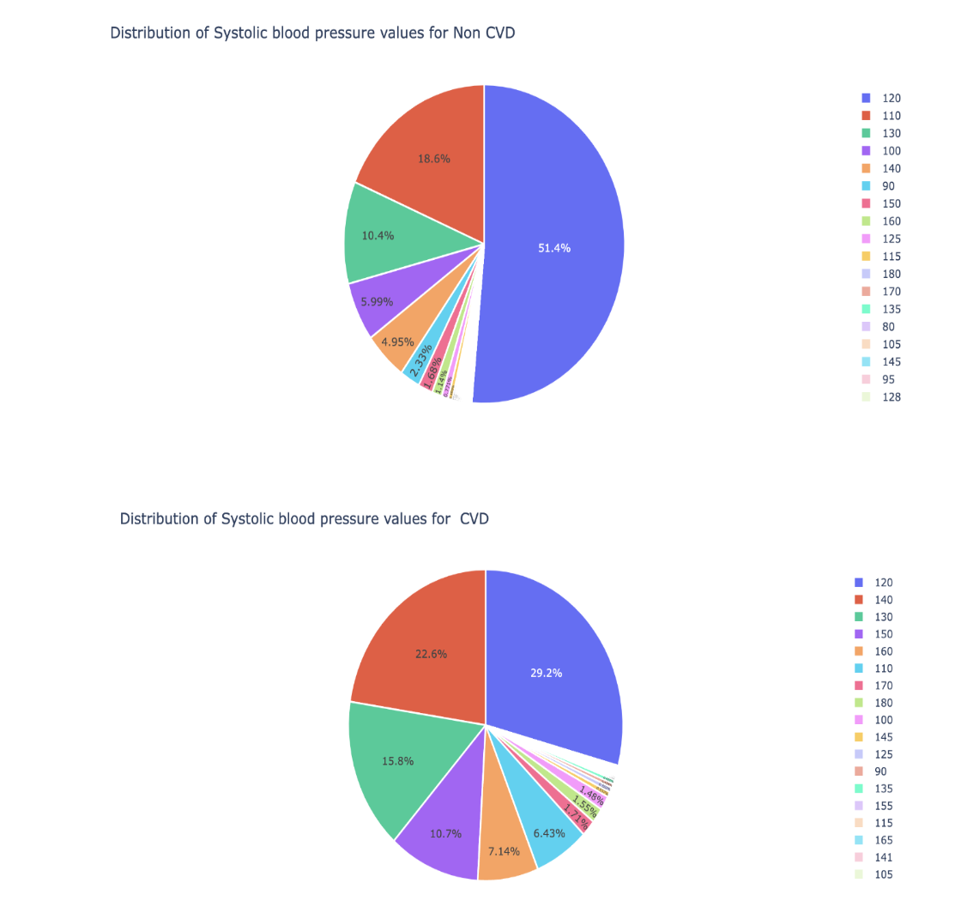
Maximum population has blood pressure level of 80 mmHg and 120 mmHg for diastolic and systolic respectively.

Slide 11
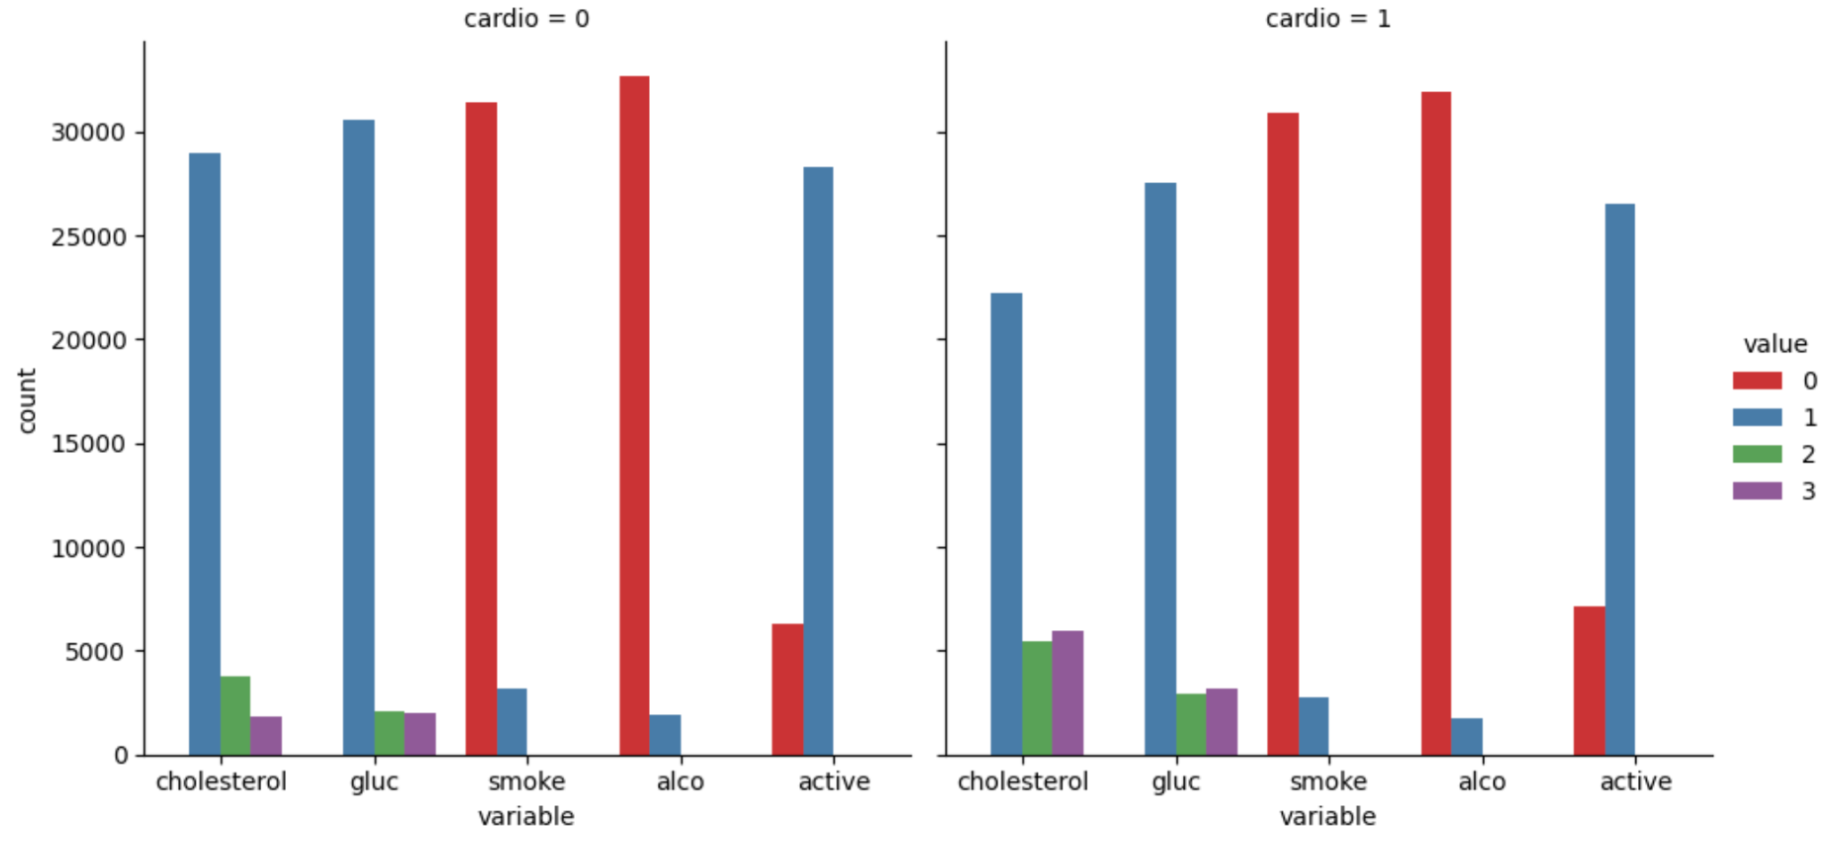
It can be clearly seen that patients with CVD have higher cholesterol and glucose level.

Slide 12
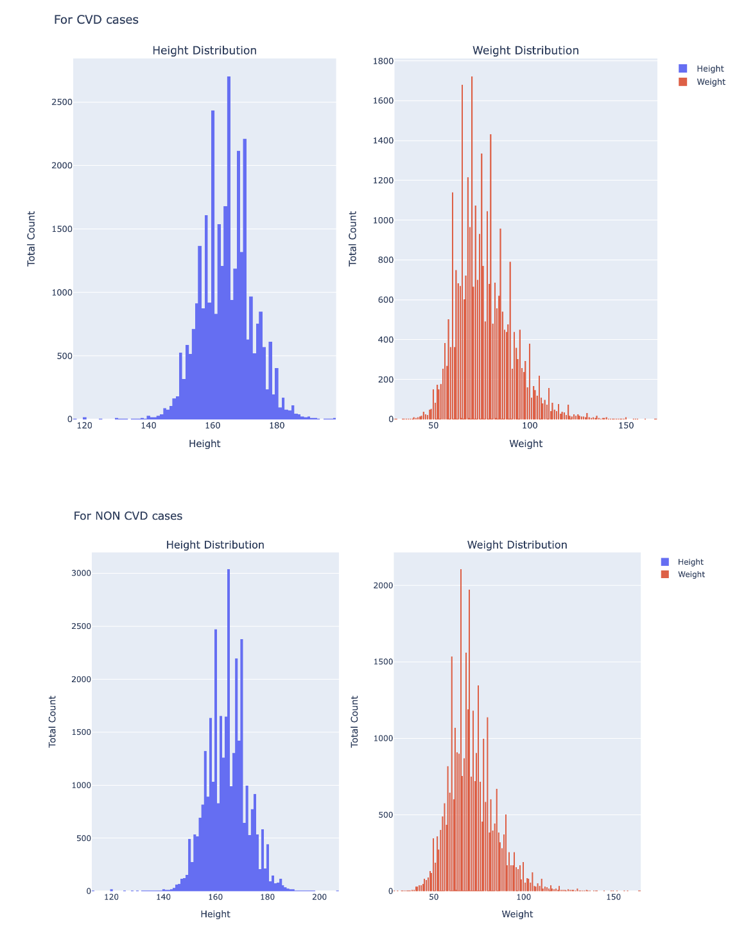
Features like Weight and Height are well distributed for Non - CVD and CVD Population.

Slide 13
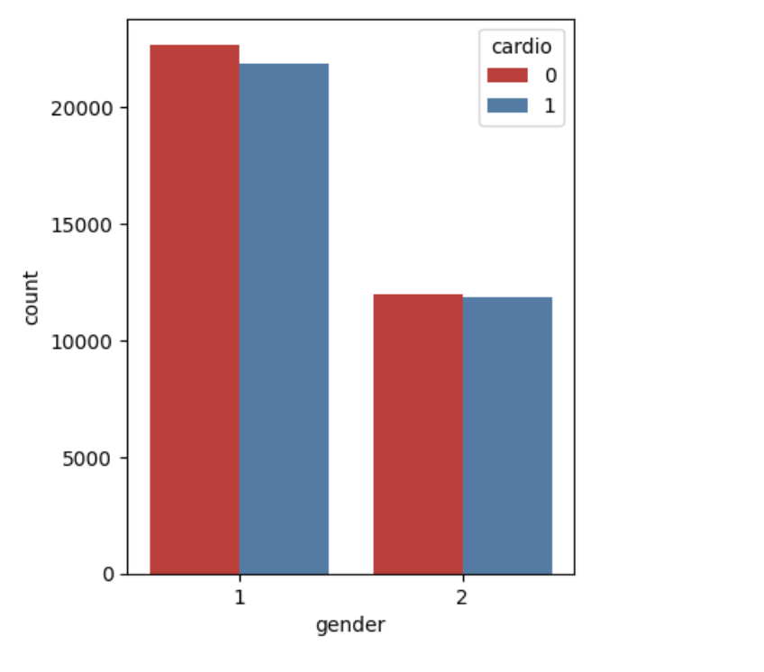
The dataset seems to be balanced for count of CVD and non CVD cases spread across both genders.
Note: 1 represents : Female
2 represents : Male

Slide 14
Predictive Analysis & Conclusion
Models implemented:
Decision Tree
Random Forest Classifier
Logistic Regression
KNN

Slide 15
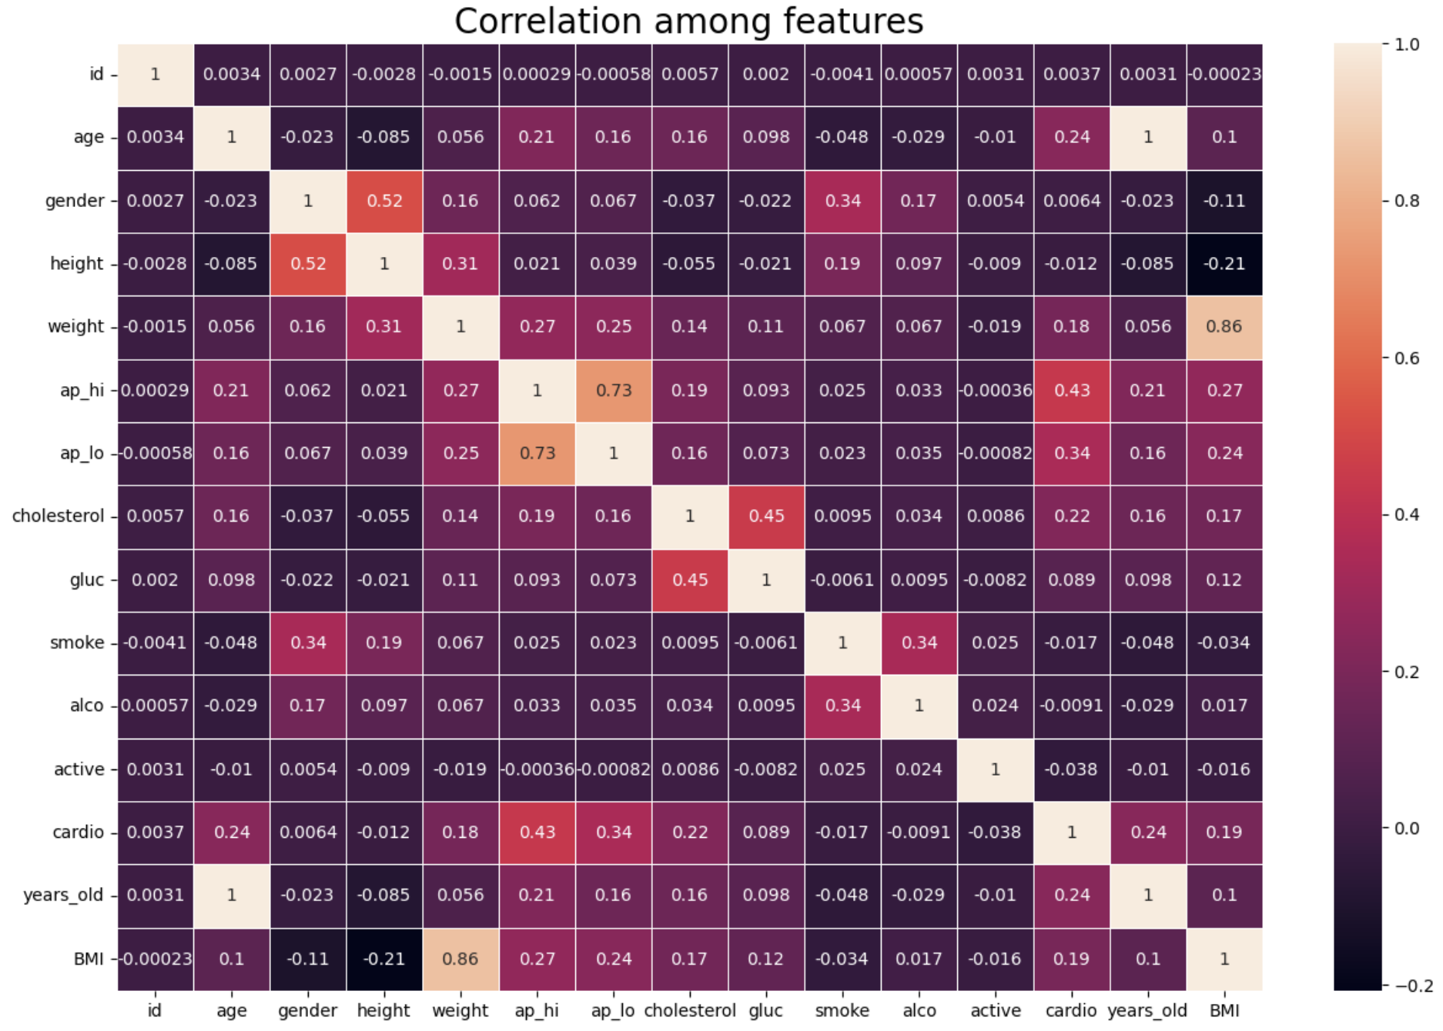

Slide 16
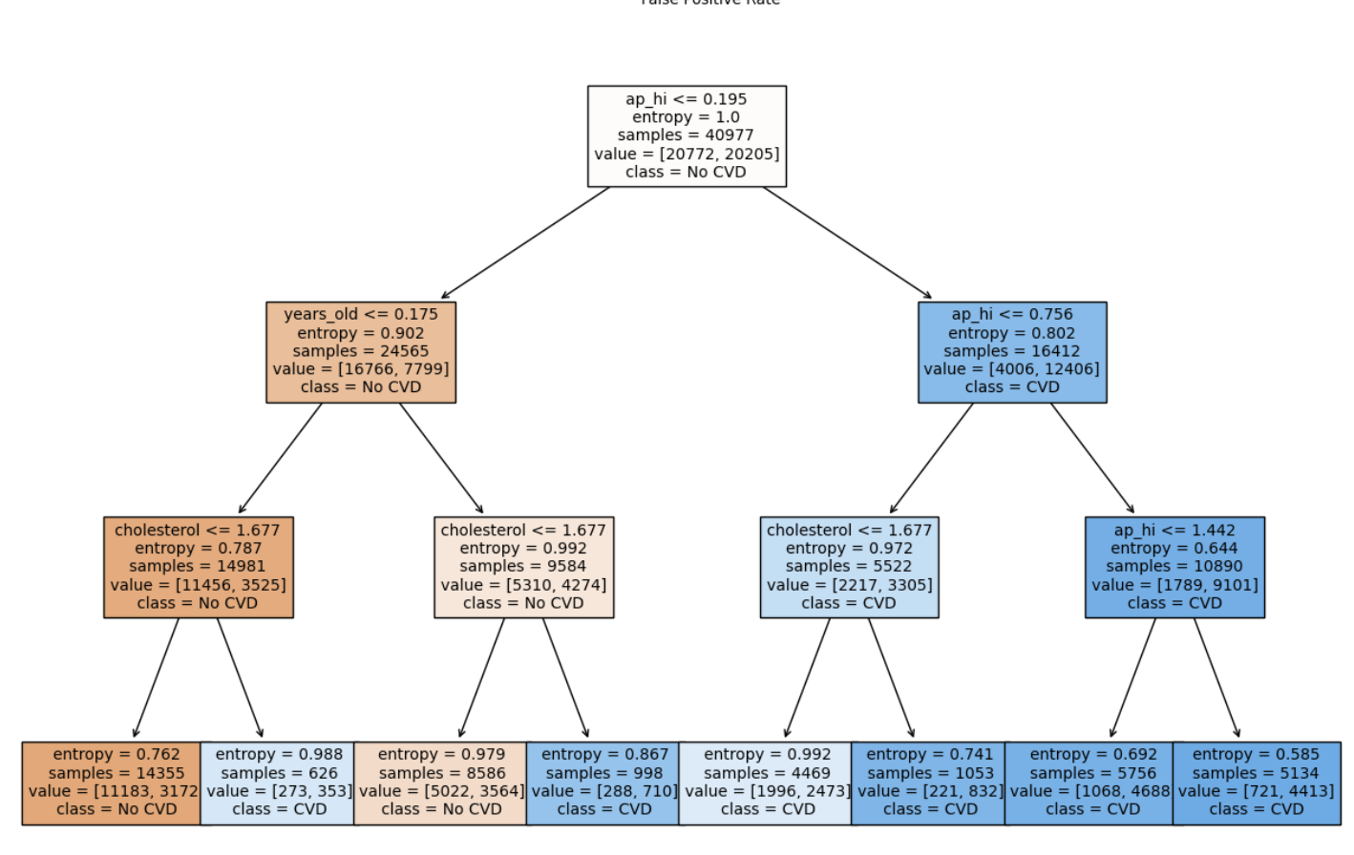
Decision Tree Model

Slide 17
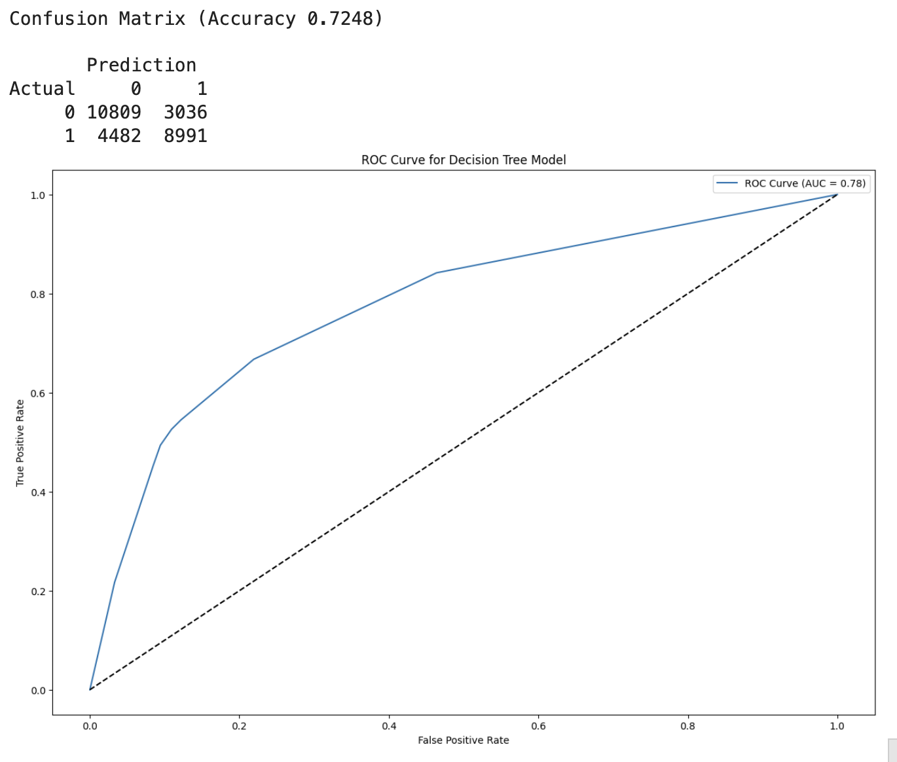
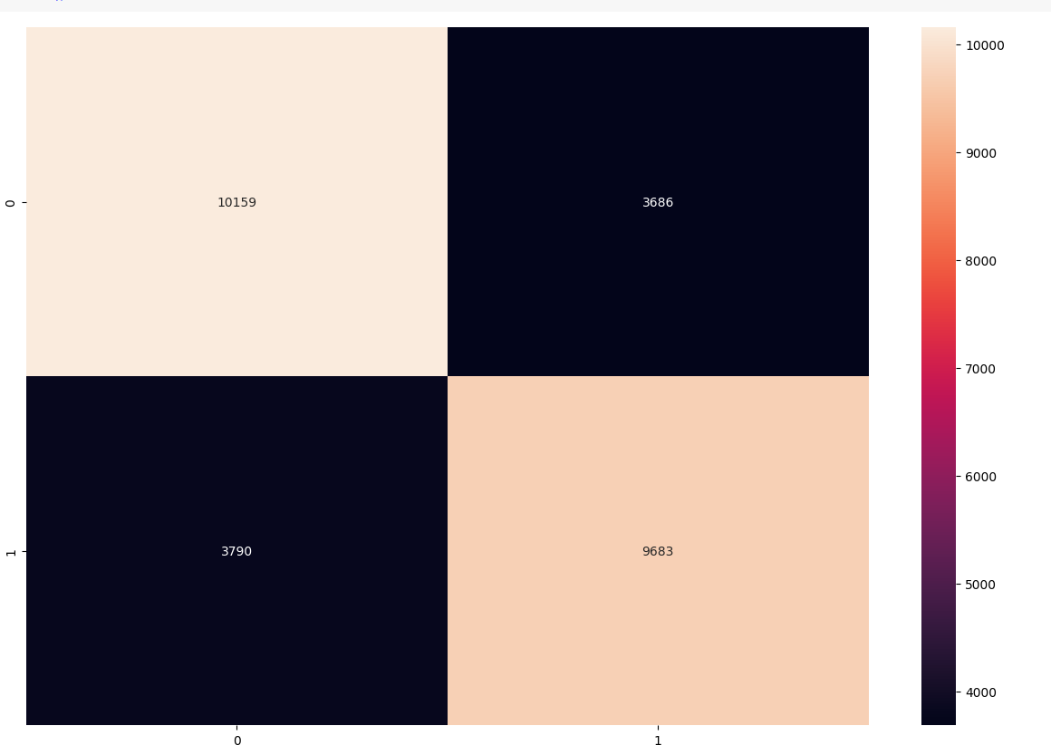
Decision Tree Model
Confusion Matrix (Accuracy 0.7263)
Prediction
Actual 0 1
0 10159 3686
1 3790 9683

Slide 18
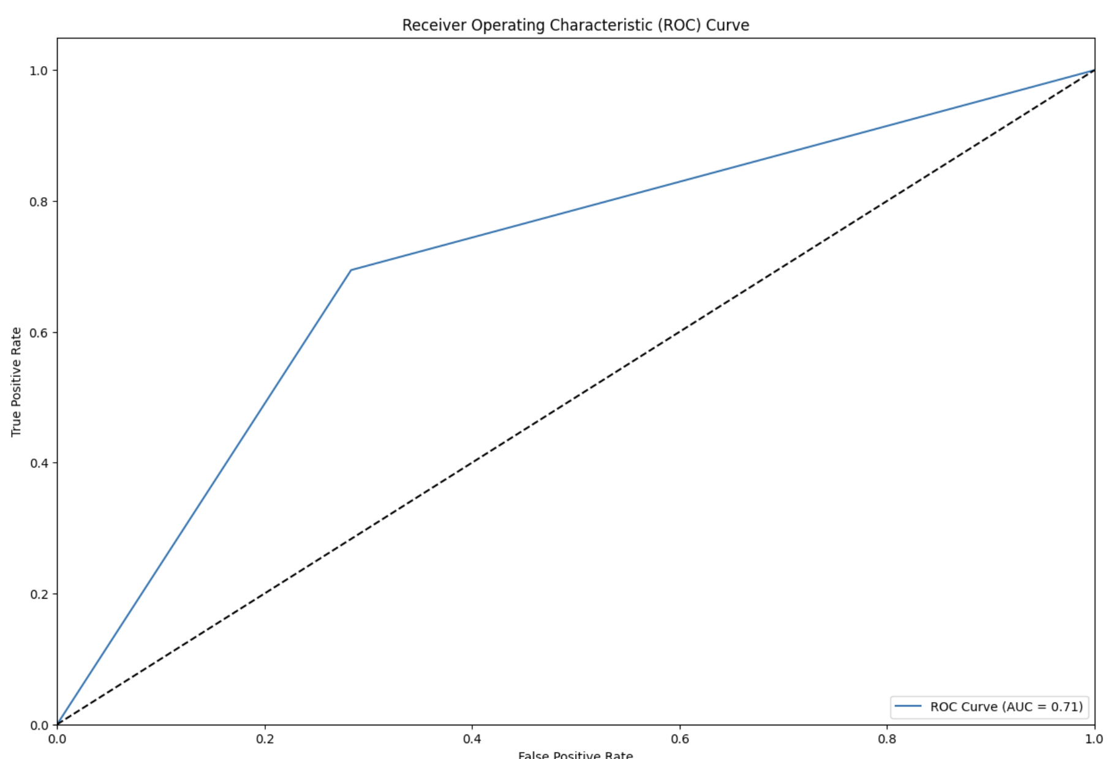
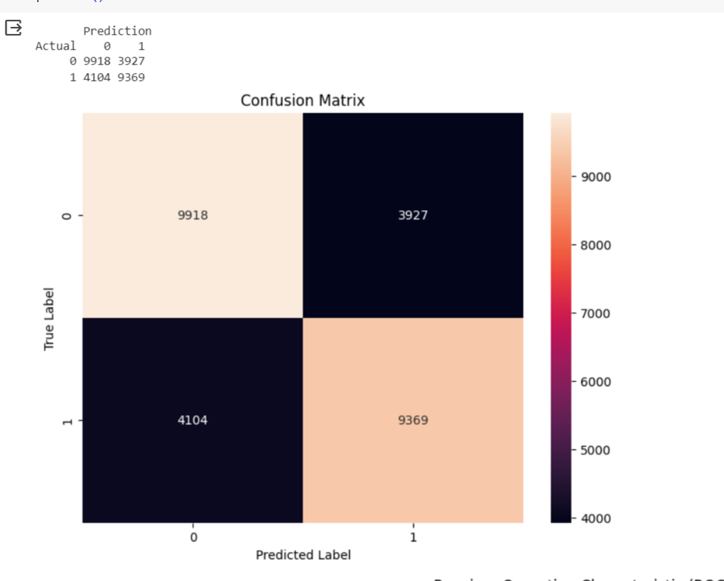
Random Forests

Slide 19
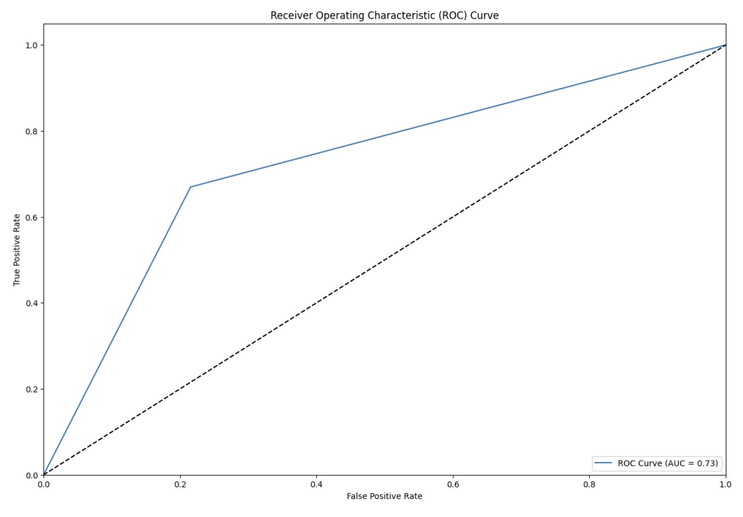
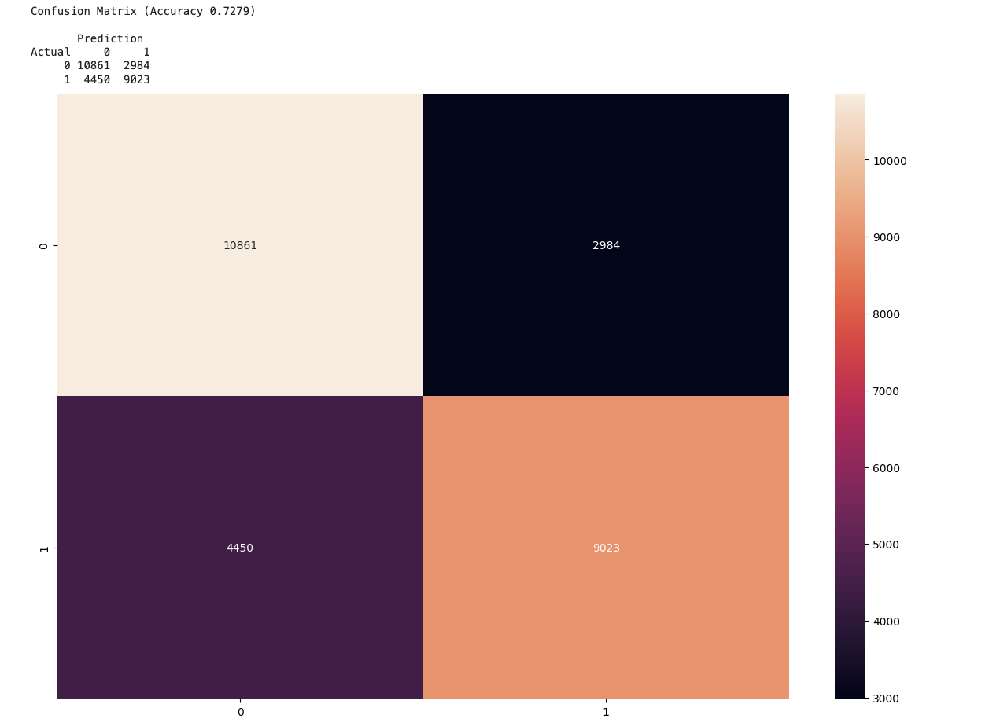
Logistic Regression

Slide 20
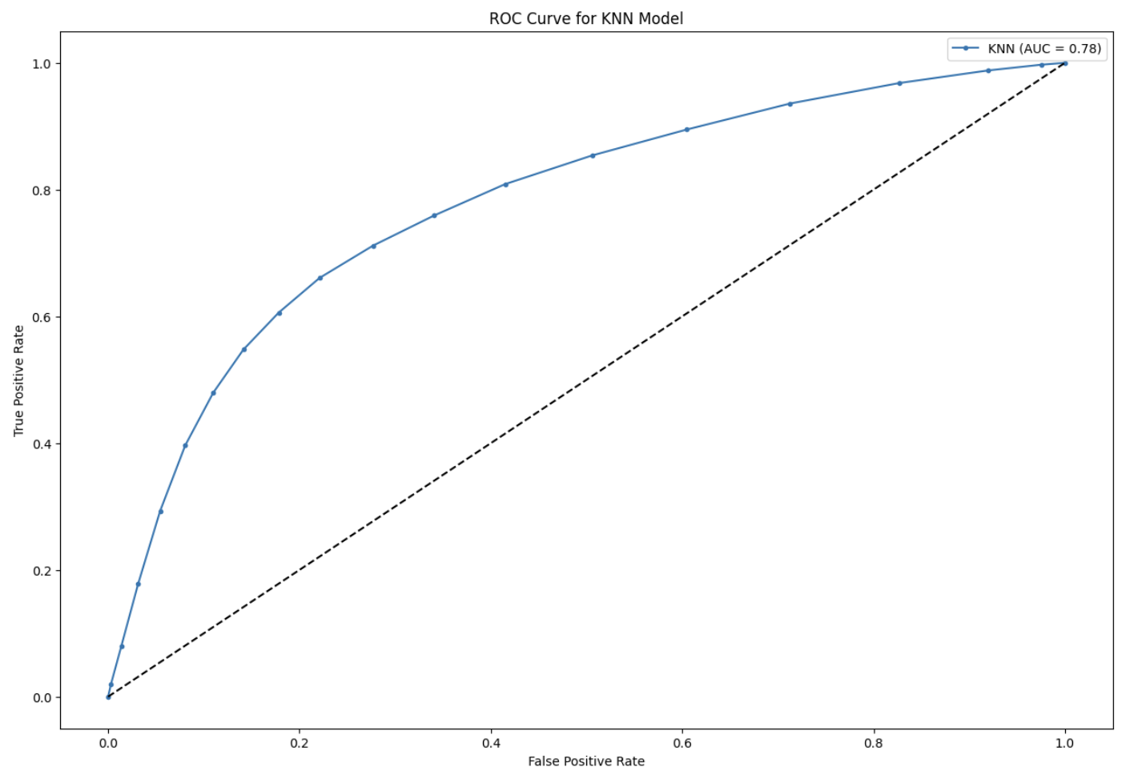
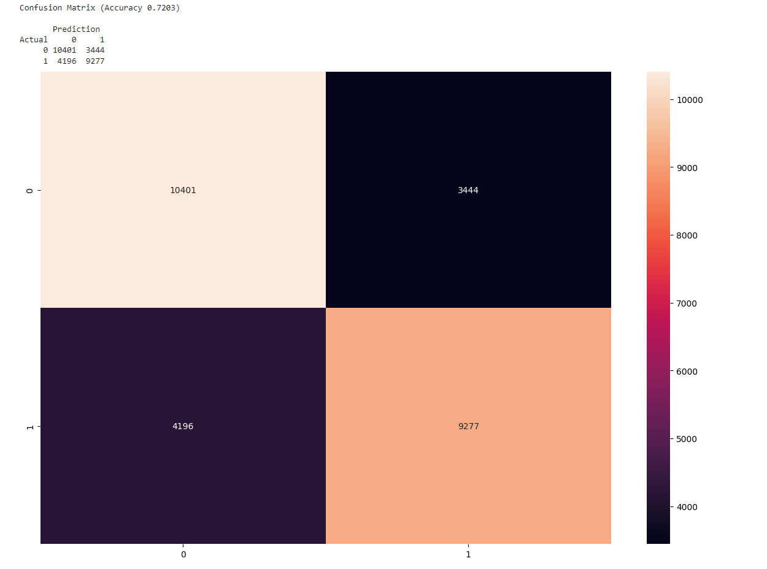
KNN Model

Slide 21
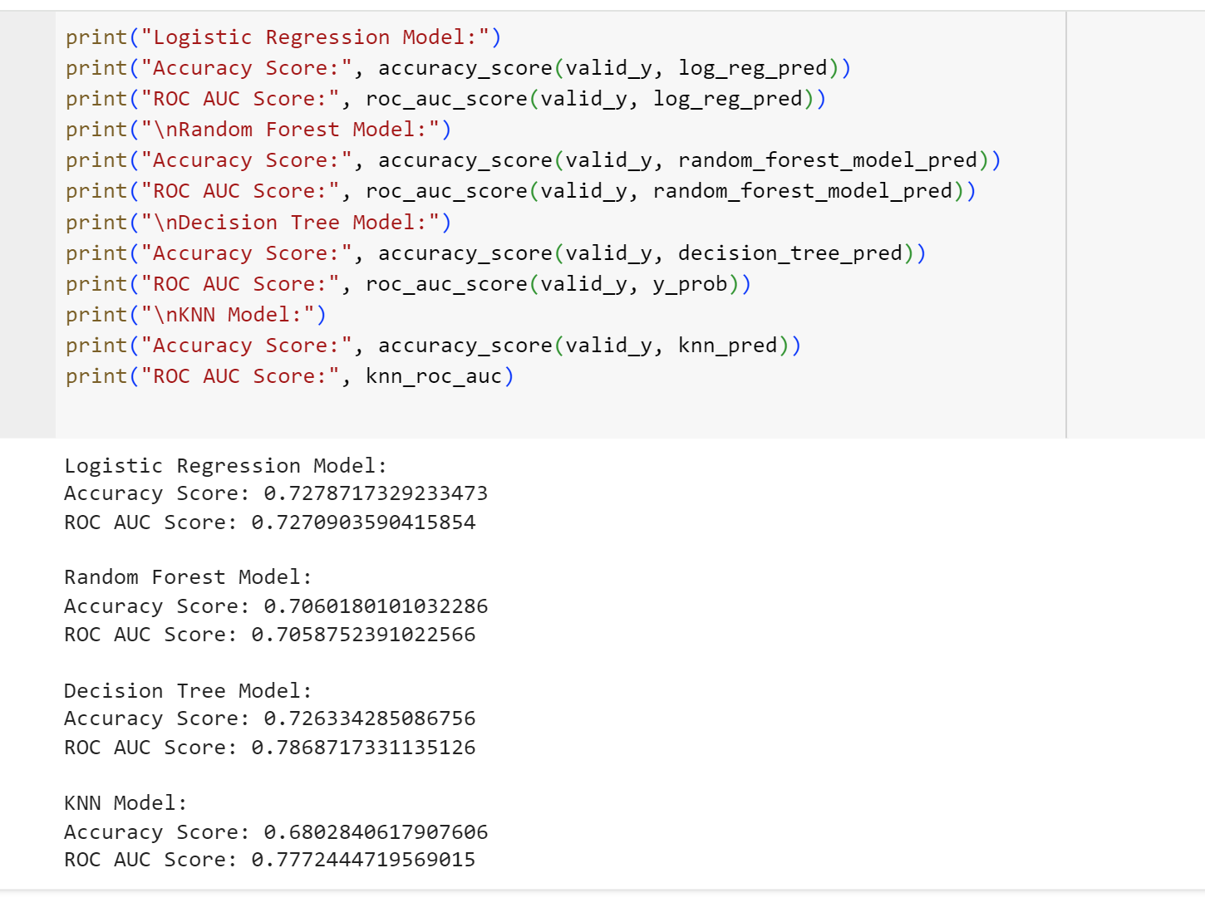
Conclusion
Models implemented:
Decision Tree
Random Forest Classifier
Logistic Regression
KNN
As per our analysis Decision Tree Model best fits.

